Slide 1
Ethics in Information Technology
Unit-I

Slide 2

Ethics
Ethics is a set of beliefs about right and wrong behavior within a society

Slide 3
Difference B/W Morals ,Ethics , Laws
Morals | Ethics | Laws
One’s personal beliefs about right and wrong | Standards or codes of behavior expected of an individual by a group to which an individual belongs (nation ,organization , profession) | Law is a system of rules that tells us that we can and cannot do (nation, organization, profession)
This may vary person to person | This may vary organization to organization or group to group | This never varies as it is permanently set by the legislative bodies
Ex: One may find cheating in exams feasible , that is morally ethical but it may not be found ethical on the grounds of law and society in which you live | Ex: One may find ethically correct to not disclose the important points to other colleague , to win higher position though it may not be found morally correct | Ex: It may not be found good that if a person has found out to be guilty could be ethically incorrect but under law he/she has full right to hire a lawyer to defend himself

Slide 4
Ethics in Business World
Leadership : The conscious effort to integrate,adopt,and emulate to guide decisions and behavior of all aspects of personal life
Accountability : Holding yourself and other’s responsible for their actions, commitment towards your organization
Integrity : It means to extend to all people the same respect and consideration that you expect to receive from others. Consistency , is obviously hard to achieve, particularly when you are in a situation that conflicts with your morals .Example : when you work more than your working hours for your colleague then , you never demand for the pay but, when you work for your organization then, immediate cause for overtime pay comes in your mind

Slide 5
Respect for others: To foster ethical behavior and environments in the workplace, respecting others is a critical component. Everyone deserves dignity, privacy, equality, opportunity, compassion, and empathy.
Honesty: Honesty and commitment towards your work , bad news should also be communicated and received in the same manner as that of good news for the organization
Responsibility : Everyone should be responsible enough for the duties toward organisation and towards your co-workers
Fairness : Everyone should fair enough to give equal opportunities, and be treated the same. If a practice or behavior would make you feel uncomfortable or place personal or corporate benefit in front of equality, common courtesy, and respect, it is likely not fair.
Environmental Concerns: In a world where resources are limited, ecosystems have been damaged by past practices, and the climate is changing, it is of utmost importance to be aware of and concerned about the environmental impacts a business has. All employees should be encouraged to discover and report solutions for practices that can add to damages already done.

Slide 6
Why Business ethics?????
Gaining the goodwill of the community
Although organizations exist primarily to earn profits or provide services to customers, they also have some fundamental responsibilities to society . As a result , many organisations initiate or support socially responsible activities , which may include making contributions to charitable organisations , providing benefits for employees in excess of any legal requirements . For example : a company known for treating its employees well will find it easier to compete for the best job candidates .
Creating an Organisation That Operates Consistently
Organisations develop and abide by values to create an organisational culture and to define a consistent approach for dealing with the needs of their stakeholders i.e. shareholders, employees, customers, suppliers, and the community . Such consistency ensures that employees know what is expected of them and can employ the organisations value to help in decision making . For example: Google invested $250 million in solar and wind power projects, which depicts its one of the socially responsible activities

Slide 7
Fostering Good Business Practices
In many cases , good ethics can mean good business and improved profits. Companies provide excellent service to retain their customers instead of losing them to competitors. Suppliers and other business partners often place a priority on working with companies that operate in a fair and ethical manner. All these factors tend to increase revenue and profits while decreasing expenses. As a result , ethical companies tend to be more profitable over the long term than unethical companies . On the other hand , bad ethics can lead to bad business results. Bad ethics can have a negative impact on employees, many of whom may develop negative attitudes if they perceive a difference. When such discrepancy between employee and organization occur then, it destroys the employee commitment towards organization.
Protecting the Organization and its Employees from Legal Action
In 1909 ruling (United states v. New York Central& Hudson River Railroad Co.),the U.S Supreme Court established that an employer can be held responsible for the acts of its employees even if the employees act in a manner contrary to cooperate policy and their employer’s directions. The principle established is called Respondent Superior , or “let the master answer”

Slide 8
The CEO and the general counsel of IT solutions and services provider GSTI Corporation were forced by Small Business Administration (SBA) to resign , while three other top GSTI executives were suspended , due to allegations that GTSI employees were involved in a scheme with its contracting partners that resulted in the firm receiving money set aside for small businesses. GSTI , which had over 500 employees and revenue over $760 million , was providing services and being paid most of the fees.
Avoiding Unfavorable Publicity
The public reputation of a company strongly influences the value of its stock , how consumers regard its products and services , the degree of oversight it receives from government agencies and the amount of support and co-operation it receives from its business partners. Thus many organization are motivated to build a strong ethics program to avoid negative publicity. For example : In 2012 , Google agreed to pay a fine $22.5 million to end an FTC (Federal Trade Commission investigation into allegation that the firm utilized cookies and bypassed privacy settings to track the online habits of people using Apple’s Safari browser. Recently , also Google's Been Fined $162 Million In India for abusing its commanding position in the smartphone market.

Slide 9
Types of Business Ethics
Corporate Social Responsibility
Corporate social responsibility (CSR) is the concept of meeting the needs of stakeholders while accounting for the impact meeting those needs has on employees, the environment, society, and the community in which the business operates. Of course, finances and profits are important, but they should be secondary to the welfare of society, customers, and employees—because studies have concluded that corporate governance and ethical practices increase financial performance.
Transparency and Trustworthiness
It's essential for companies to ensure they are reporting their financial performance in a way that is transparent. This not only applies to required financial reports but all reports in general. For example, many corporations publish annual reports to their shareholders. Most of these reports outline not only the submitted reports to regulators, but how and why decisions were made

Slide 10
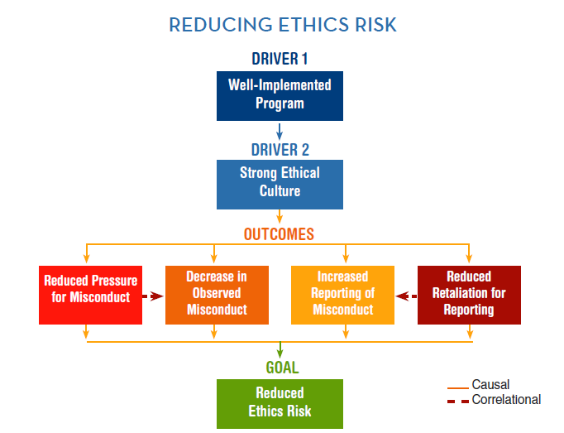

Slide 11
How an Ethical Work Environment could be created??????
1. Face the complexity involved in making ethical choices. Don’t oversimplify decisions.
Openly discuss the ethical grey areas and acknowledge the complexity of work life. Involve others in more of the ethical decisions. Be a leader who talks about the difficult ethical choices, and help others learn to take responsibility for making ethical decisions carefully.
2. Talk about the right thing to do in the context of your daily challenges. Don’t separate ethics from day-to-day business.
Make it clear to your people that ethics is “the way we operate” and not a training program or reference manual. Every activity, whether it is a training program, a client meeting, or an important top management strategy session, should include conversations about ethics.

Slide 12
3. Demonstrate respect for everyone all the time. Don’t allow negative interpersonal behaviors to erode trust.
Make respect a load-bearing beam in your culture. Be an ethical leader who expects it and practices it. Cultivate a respectful environment where people can speak up about ethics and share the responsibility for living it. Build trust, demand open communication and share the ownership of organizational values.
4. Take responsibility broadly, and reach for the highest level of ethical leadership. Don’t think about ethics as just following laws and regulations.
Take action and show consumers and other stakeholders that you are actively engaged with ethical issues that matter. Recognize how ethics influences their reasons to buy from you, and demonstrate your commitment to go beyond mere compliance with laws and regulations. Prove that you are committed to ethical issues, including human rights, social justice and sustainability.

Slide 13
5. Hold everyone accountable, and expect leaders to model the standards. Don’t exempt anyone from meeting ethical expectations.
Allow no excuses. Make sure that no one is exempted from meeting the ethical standards you adopt. Maintain the status of ethics as a total, absolute, “must do” in the organization. Hold everyone, particularly senior leaders and high profile managers, accountable. No exceptions!
6. When you talk about ethics, don’t just talk about the negative. Celebrate positive ethical moments.
Be a proactive ethical leader, championing high ethical conduct, and emphasizing prevention. Talk about what positive ethics looks like in practice as often as you talk about what to avoid. Take time to celebrate positive ethical choices.

Slide 14
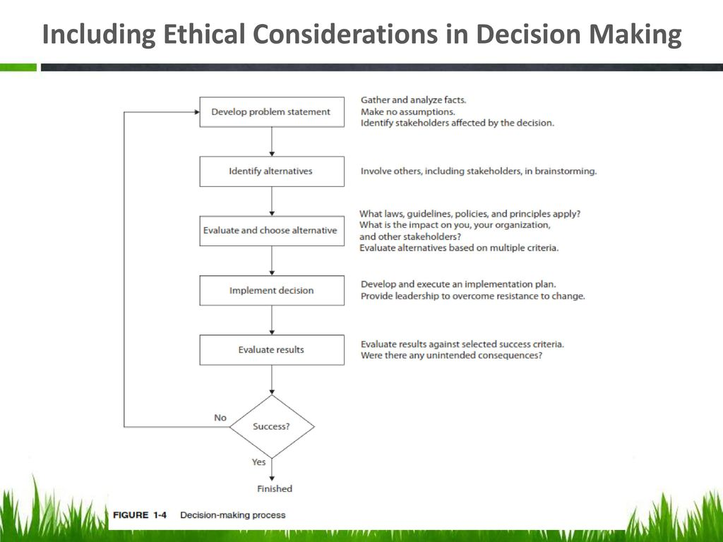

Slide 15
Ethics in IT
The growth of the internet , the ability to capture and store vast amount of personal data and greater reliance on information systems in all aspects of life have increased the risk that information technology , will be used unethically.
Examples:Many employees might have their and Internet access monitored while at work, as employers struggle to balance their need to manage important company assets and work time with employees’ desire for privacy and self-direction.
Hackers break into databases of financial and retail institutions to steal customer information, and then use it to commit identity theft—opening new accounts and charging purchases to unsuspecting victims
Web sites plant cookies or spyware on visitors’ hard drives to track their online purchases and activities.

